Slide 1
Post Benefits Advisor (Philippines)
Training & Continuity Manual
Version 1- Sept 2026
Prepared by:
Vernon Lask
VFW DPA DSO

Slide 2
Post Benefits Advisor Responsibilities
The Post Benefits Advisor shall advise members of the Post, their family members and survivors of benefits and services that are available in the local community such as homeless services, employment opportunities, and companies that offer discounted goods or services to veterans.
The Post Benefits Advisor shall direct individuals seeking Federal benefits assistance to the Department Benefits Advisor.
The work of a Post Benefits Advisor shall be performed in accordance with the instructions contained in the VFW Guide for Post Benefits Advisors under the general supervision of the Post Commander.
The Post Benefits Advisor shall perform such other duties as may be incident to the office and as may from time to time be required by the laws and usages of this organization or lawful orders from proper authority.
Reference: VFWDigitalPodiumEdition2025

Slide 3
Benefit Advisors Do’s and Don’ts
DO’s
The main duty is to inform members, families, and survivors about available benefits and local community services, such as homelessness resources, job opportunities, and veteran discounts.
Assist Veterans, Widows, Dependents with banking and insurance issues in the US.
Refer individuals seeking Federal Benefits to the Department Benefits Advisor or an ADSO.
Keep the latest VFW Guide for Benefit Advisors and follow established procedures and guidelines.
Work under the supervision of the Post Commander and participate in mandatory training sessions.
District Benefits Advisors must support Benefit Advisors, including ensuring their attendance at required training.

Slide 4
Benefit Advisors Do’s and Don’ts
Don'ts
Do not communicate about claims directly with the VA or other agencies unless you have a VA Form 21-0845 Third Party Consent from the claimant; all status updates must go through the DSO.
When acting as a recorder, only write down information provided by the claimant; do not offer advice on how to present information and DON’T keep any forms or personal information—return all documents promptly.
Do not give advice or opinions on individual claims; only provide general information about government benefit programs, forms, contact information, and what types of evidence are needed. Refer to ADSO or DSO when possible.
Don’t include any personally identifiable information when submitting your report at each Post business meeting summarizing activities since the last meeting.
Do not set or solicit office hours at VA facilities (regional offices, hospitals, outpatient clinics, or Vet Centers).
District Benefits Advisors must support Benefit Advisors, including ensuring their attendance at required training.

Slide 5
Newly added to the
Policy and Procedures
A summary of the substantive changes to the Policy and Procedure are as follows:
Change 1:Page 22: Insert new Item 10 under VFW Representation Technical
10. If a veteran or client requests a specific gender of representative, the service office shall make a
reasonable attempt to honor that request.
Rationale: Veterans will sometimes make requests for a specific gender of representative due to a myriad
of personal reasons. This addition allows service offices to honor these requests if they are reasonably able to
do so.
Change 2: Page 35: Insert New #7 under Code of Conduct for Representatives
7. VFW Representatives must conduct themselves professionally at all VFW and NVS sponsored events.
If a representative is observed to be acting unprofessionally or inappropriately during a VFW or NVS event,
they may be removed at the discretion of the Director or Deputy Directors, NVS. Any expenses incurred
as a result of removal from an event shall be the responsibility of the individual and/or Department.
Rationale: We must ensure that our representatives are acting professionally and appropriately at all
VFW events including NVS training conferences. This amendment would allow NVS to respond
appropriately to any potential issues that may arise as a result of misconduct during a VFW event.

Slide 6
Important Phone Numbers
US Embassy Manila +63 2 5301 2000
  Contact to American Services
  Contact JUSMAGPHIL
    DEERS (Must make an appointment through the US Embassy web site)
    ID Cards (Must make an appointment through the US Embassy web site)
VA Manila +(63)28 550 3888 (international) 028 550 3888 0r #6982 (In the Philippines)
  Push 1 for VA Manila Regional Office
  Push 2 for VA Manila Medical Clinic and Pharmacy
  Push 3 for VES services
  Push 4 for FMP
  Push 5 for other Stateside toll-free numbers
Tri-Care SOS
  +(65) 6339-2676 / 02 8687 8656 (Local number that transfers to Singapore)

Slide 7
Important Phone Numbers (cont.)
Social Security (US Embassy Manila)
  Email
    You may contact us in a variety of ways, but the most efficient way is to contact us by e-mail at FBU.Manila@ssa.gov. We generally respond within 10 – 15 business days from the date of receipt.
  Phone
    You may call us at +63-2-5301-6200 from 8:00 AM to 11:00 AM (Manila Time) every Tuesday and Thursday, except on U.S. and Philippine holidays.
  In-Office Appointments
    In-person services are limited to appointment only. Walk-ins are not allowed. Appointments are available on Mondays and Fridays from 8:00 AM to 11:30 AM. To request for an appointment, please send an e-mail to FBU.Manila@ssa.gov (Subject: Appointment Request) and we will contact you to schedule the appointment. Please note that electronic devices (e.g., mobile phones, laptops, etc.) are not allowed inside the Embassy.
  Facsimile or Postal Mail
  You may send your inquiry via fax to +632-8708-9714 or write to us at the following address:
Mailing Address:
U.S. Embassy – Manila Social Security Administration 1201 Roxas Boulevard Manila, Philippines 0930

Slide 8
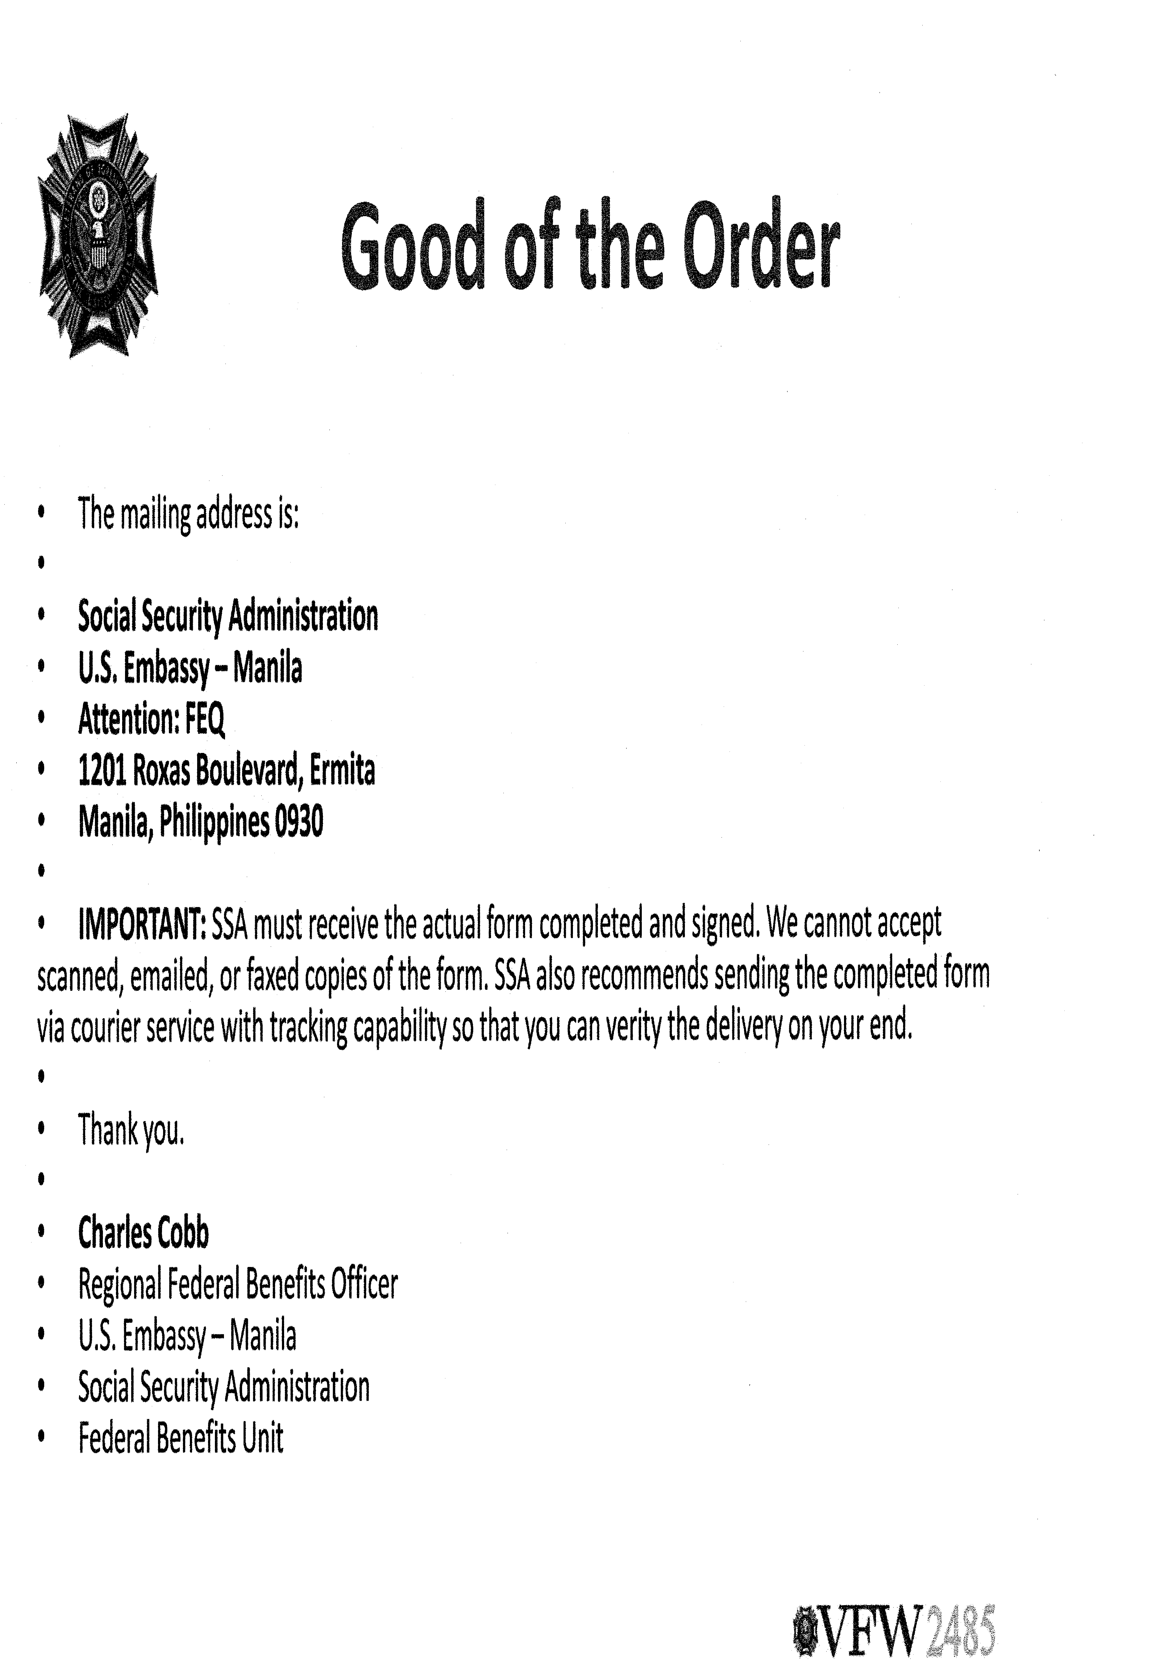
Note from SS Regional Federal Benefits Officer Manila

Slide 9
DEERS
Defense Enrollment Eligibility Reporting System
It is an automated system that maintains information about military members and their families who are eligible for various military benefits and entitlements.

Slide 10
Why is DEERS So Important?
To receive any military benefits, you must be enrolled in DEERS. If you have ever been denied access to a military installation or were unable to shop at the commissary or exchange, an error in DEERS may have been the cause.
The DEERS system is most commonly recognized for its essential role in issuing military ID cards. However, the information it maintains also establishes eligibility for a wide range of benefits, including:
On‑base housing
Educational benefits
Medical benefits — including FEDVIP dental and vision programs
Dental benefits
Life insurance (SGLI)
Because DEERS supports so many critical benefits, it is important that you and your spouse keep your DEERS information accurate and up to date. Failure to do so may result in denial of entitlements or delays in accessing benefits.

Slide 11
DEERS and Identification Cards
Military members, dependents, and eligible veterans receive a military identification card as part of DEERS enrollment..
Documents Needed for DEERS Enrollment or Verification:
Birth certificate
Marriage certificate
Social security card
Photo ID
Additional Requirements for Dependents (ID Card Issuance/Renewal)
Sponsor present, or
A valid Power of Attorney, or
A DD Form 1172‑2 completed and signed by the sponsor
Scheduling an Appointment
Appointments are required for receiving or renewing an ID card.
Schedule online or by contacting your nearest RAPIDS office.

Slide 12
Retirees and DEERS
Medicare & DEERS Updates
Retirees must update their DEERS information once they become eligible for Medicare (typically at age 65).
Failure to update DEERS may result in delays or loss of access to military benefits.
How to Update DEERS
Updates can be completed at any RAPIDS office.
Bring two forms of valid government‑issued identification.
Ensure all personal and dependent information is accurate and current.
Where to Learn More
Visit milConnect for:
      Detailed DEERS information
      Benefit eligibility guidance
      Instructions for updating or correcting DEERS records

Slide 13
DEERS and TRICARE®
TRICARE & DEERS Enrollment
According to TRICARE®, you must be registered in DEERS to use your benefits.
Sponsors are automatically enrolled when they enter military service.
Family members must be added when qualifying life events occur.
Sponsor Requirements
If both spouses are service members and have a child, one parent must be listed as the child’s sponsor in DEERS.
Why Accurate DEERS Information Matters
For claims such as:
Referrals
Prescriptions
Treatments
Other TRICARE services
All DEERS information must be correct and up‑to‑date for proper processing.

Slide 14
TRICARE® Overseas Program
The TRICARE Overseas Program (TOP) provides health care coverage for:
  Active‑Duty Service Members
  Active‑Duty Family Members
  Retirees
  Other eligible beneficiaries
TOP applies to all geographical areas and waters outside the United States.
International SOS Support
International SOS administers TRICARE Overseas.
Ensures access to quality health care for U.S. military members and families living or traveling abroad.
Provides coordination, assistance, and support regardless of location.

Slide 15
TRICARE® Contact Information
International SOS Support
Provides 24/7 customer service and assistance for TRICARE Overseas beneficiaries.
Supports:
  Enrollment questions
  Provider education
  Claims assistance
  General TRICARE Overseas guidance
Important Phone Number Information
Toll‑free numbers are not available in all locations.
If no toll‑free number is listed for your area, use the regional direct number.
If a toll‑free number requires an access code, dial the access code before the toll‑free number.
Customer Service – Regional Direct
+65 6339‑2676 (Singapore)
02 8687 8656 (Local PH number that transfers to Singapore)
Customer Service – Toll Free
1 800‑144‑10576

Slide 16
TRICARE® and Medicare
TRICARE For Life Eligibility
To qualify for TRICARE® For Life, both the veteran and their eligible spouse (age 65+) must be enrolled in Medicare Part B.
Medicare enrollment is required even though Medicare cannot be used outside the United States.
Medicare Part B enrollment ensures continued TRICARE coverage.
Why Enrollment Matters
Some veterans choose not to enroll in Medicare because they have other insurance.
Opting out of Medicare Part B can result in loss of TRICARE benefits.
Many who decline Medicare to save money later regret the decision when a life‑changing event occurs and they cannot access TRICARE.

Slide 17
TRICARE® - Qualifying Life Event (QLE)
You can apply for TRICARE outside of the open enrollment period if you experience a Qualifying Life Event (QLE). These events allow you to enroll in or change your TRICARE plan. Some known exceptions include:
Military Changes:
  Activating or deactivating from active duty
  Retiring from active duty
  Separating from the military
  Receiving a change in military orders
Family Changes:
  Marriage or divorce
  Birth or adoption of a child
  Death of a sponsor or family member
  Loss or gain of other health insurance
Government-Directed Changes:
Moving to a new location
Becoming eligible for Medicare
Changes in TRICARE program eligibility
If you experience a QLE, you typically have 90 days from the date of the event to make changes to your TRICARE coverage.

Slide 18
Claim Form to file for TRICARE®
DD Form 2642 – Patient’s Request for Medical Payment
Required Information:
Patient Information
  Full name
  Address
  Contact details
Sponsor Information
  Sponsor’s Social Security Number (SSN) or
  Department of Defense Benefits Number (DBN)
Other Health Insurance (OHI)
  Details of any additional health insurance coverage
Diagnosis & Treatment Details
  Diagnosis codes
  Dates of service
  Description of medical services received
Provider Information
  Provider’s name
  Address
  Contact details
Signature Requirement
  Must be signed by the patient or an authorized representative

Slide 19
Filing an FMP/TRICARE® Claim Sample
FMP/Tri-Care
Date of Service | Service Rendered | Provider | Disability | Cost
9/10/2023 | Needed medicine change. Office Visit and Medicine | Dr Erwin Brian Tan, The British Medical; Dental and Cosmetic Center, Horizon Tower 0ne, 282 Don Juico Ave, Brgy Malabanias, Angeles City, Philippines 2009 Ph +639778498100, Email info@TheRoyalBritish.uk | Hypertension Heart Disease - 7007 | ₱1,127.91
9/18/2023 | Office visit for Medicine | Dr Erwin Brian Tan, The British Medica; Dental and Cosmetic Center, Horizon Tower 0ne, 282 Don Juico Ave, Brgy Malabanias, Angeles City, Philippines 2009 Ph +639778498100, Email info@TheRoyalBritish.uk | Hypertension Heart Disease - 7007 | ₱463.82
9/20/2023 | Office visit for Exam and Test | Dr Erwin Brian Tan, The British Medica; Dental and Cosmetic Center, Horizon Tower 0ne, 282 Don Juico Ave, Brgy Malabanias, Angeles City, Philippines 2009 Ph +639778498100, Email info@TheRoyalBritish.uk | Hypertension Heart Disease - 7007, Varicose Vein - 8515 | ₱15,726.00
10/11/2023 | Office visit for Exam and Test, Doppler Studies | Our Lady of Mt Carmel Medical Center, Mac Arthur Hi-Way, Brgy, City of San Fernand0, Pampanga, Philippines, Ph. : +63 0458605977 | Hypertension Heart Disease - 7007 | ₱4,400.00
 |  |  | Total | ₱21,717.73

Slide 20
Foreign Medical Program (FMP)
Foreign Medical Program (FMP) Overview
VA provides medical services to eligible Veterans living or traveling abroad through the Foreign Medical Program (FMP).
FMP covers care only for service‑connected conditions and conditions aggravating a service‑connected disability.
What FMP Will Pay For
Health care services related to service‑connected conditions
Medications prescribed for service‑connected conditions
Durable medical equipment (DME) required for service‑connected conditions
Treatment for conditions associated with or aggravating a service‑connected disability
Special Authorization
VA may authorize foreign medical services for any condition if the Veteran is participating in the VA Vocational Rehabilitation Program
  (Title 38, U.S. Code, Chapter 31)

Slide 21
FMP Registration Is Now Online What Changed:
Foreign Medical Program (FMP) Modernization
VA has revamped the Foreign Medical Program (FMP) to support Veterans living outside the United States.
Veterans can now apply, update information, and manage enrollment entirely online through VA.gov.
What This Modernization Means
No more mailing VA Form 10‑7959f
No more waiting weeks for manual processing
No more faxing or emailing documents
Immediate confirmation that your application was received
Who Benefits Most
This upgrade is especially helpful for Veterans living in:
  Philippines
  Thailand
  Japan
  Korea
  Other Pacific Areas

Slide 22
Foreign Medical Program (FMP)
VHA Office of Integrated Veteran Care
Foreign Medical Program (FMP)
P.O. Box 469061
Denver, CO 80246-9061
Foreign Medical Program Office: 877-345-8179.

Slide 23
Care and Services through FMP
FMP Covered Services
We cover medically necessary care and services used to treat a service‑connected disability. Covered services include:
Outpatient care (office visits)
Inpatient care (hospital stays)
Emergency and urgent care
Medical equipment, devices, and supplies prescribed to support daily activities — including prosthetics
Skilled nursing care
  Medication management
  Wound care
  Recovery‑related medical needs
Physical therapy
Prescription medications approved by the Food and Drug Administration (FDA)

Slide 24
Care and Services not covered by FMP
FMP Non‑Covered Services
FMP does not cover care or services unrelated to a service‑connected disability. Examples include:
Treatments not accepted by VA or the U.S. medical community
  Includes experimental procedures
  Includes medications not approved by the FDA
Long‑term care in:
  Nursing homes
  Assisted living facilities
  Mental health facilities
  Adult day health centers
Non‑medical home care or companion services
Deluxe or luxury medical equipment, such as:
  Queen‑ or king‑sized beds
  Remote‑control features
  Stair‑climbing wheelchairs
Health club, spa, or exercise program memberships
Family planning services and sterilization
Gender‑affirming care

Slide 25
FMP doesn't cover Care and Services received in any of these ways:
Additional FMP Non‑Covered Situations
FMP does not cover care or services received:
Through a grant, study, or research program
In a U.S. state or territory, the District of Columbia, or Puerto Rico
From a provider or facility barred from the program
Non‑Covered Costs
FMP does not pay for:
Travel costs
Costs related to paying bills, such as:
  Postage
  Late charges
  Check‑cashing fees
Charges for services, treatments, or supplies that you are not legally required to pay

Slide 26
Claim Form to file for FMP
Required Supporting Documents
FMP Benefits Letter
  A copy of the Veteran’s official FMP eligibility letter.
Itemized Billing Statement
  Provider’s full name, medical title, office address, billing address, and phone number.
  Must list health conditions treated and dates of service.
Proof of Payment
  Receipt, or billing statement marked “Paid.”
Additional Documents (Depending on Type of Care)
Inpatient Hospital Care
  Discharge summary
  Operation report (if applicable)
Medical Devices, Equipment, Supplies, Prescription Medicines, or COVID‑19 Vaccines
  Include any relevant supporting documentation

Slide 27
Medicare
What Is Medicare?
Federal health insurance program for:
  People 65 or older
  Individuals under 65 with certain disabilities or medical conditions
Administered by the Centers for Medicare & Medicaid Services (CMS).
Because Medicare is a federal program, coverage and costs are the same nationwide, regardless of the state you live in.
How Medicare Is Funded
Medicare bills are paid from two U.S. Treasury trust funds.
Trust funds are supported by:
  Payroll taxes
  Congressional appropriations
  Other authorized federal funding sources
People with Medicare pay part of the cost through:
  Monthly premiums (medical and drug coverage)
  Deductibles
  Coinsurance

Slide 28
Medicare Requires a Social Security Number
Medicare Enrollment Requirements
To enroll in Medicare Part A and Part B, the following are required:
Valid Social Security Number (SSN)
Active record in the Social Security Administration (SSA) system
Federal Requirement
Medicare cannot be issued without an SSN — even for beneficiaries living overseas.
This is a federal rule with no exceptions.

Slide 29
Overseas Enrollment Process (Philippines, Japan, Korea, etc.)
Foreign Spouse Enrollment Pathway
Foreign spouses enroll in U.S. federal benefit programs through the:
U.S. Embassy – Federal Benefits Unit (FBU) (No travel to the United States required)
What the FBU Handles
SSN issuance for benefit purposes
Medicare Part A & Part B enrollment
Survivor benefits processing
Identity verification for federal records

Slide 30
Medicaid
Medicaid is a joint federal and state program that helps cover medical costs for some people with limited income and resources. The federal government has general rules that all state Medicaid programs must follow, but each state runs its own program. This means eligibility requirements and benefits can vary from state to state.
Medicaid offers benefits that Medicare doesn’t normally cover, like nursing home care and personal care services. People with Medicaid usually don’t pay anything for covered medical expenses but may owe a small co-payment for some items or services.

Slide 31
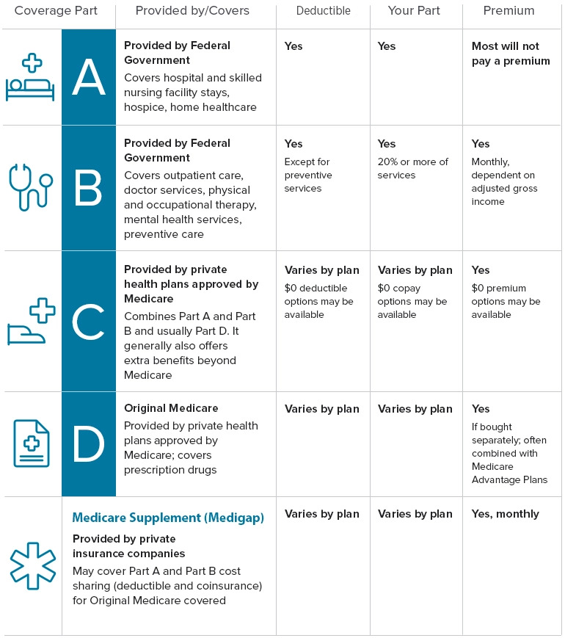
Medicare Coverage

Slide 32
Late in signing up for Medicare
Medicare Part B Late Enrollment Penalty
For every full 12‑month period you delay enrolling in Medicare Part B, your monthly Part B premium increases by 10%.
The penalty is permanent — it stays on your premium for as long as you have Part B.
Penalty Exceptions
You will not pay the 10% penalty if you had creditable coverage, such as:
Job‑based insurance from your or your spouse’s current employment
Eligibility for a Medicare Savings Program (MSP)
Key Takeaway
Delaying Part B without creditable coverage = 10% penalty per year, permanently.
Enrolling on time or maintaining employer‑based coverage = no penalty.

Slide 33
Consular Report of Birth Abroad (CRBA)
A Consular Report of Birth Abroad (CRBA) is an official U.S. government document that certifies a child acquired U.S. citizenship at birth.
Issued to children born outside the United States to a U.S. citizen parent (or parents) who meet the citizenship transmission requirements under the Immigration and Nationality Act (INA).
Non‑citizen U.S. nationals may also receive a CRBA using the non‑citizen option.
Application Requirements
CRBA applications must be submitted before the child’s 18th birthday.
Parents are strongly encouraged to apply as soon as possible after birth to avoid delays in obtaining a U.S. passport or other federal benefits.

Slide 34
CRBA Eligibility Requirements
Are CRBAs Treated the Same Worldwide?
Yes. Consular Reports of Birth Abroad (CRBAs) follow standardized U.S. federal rules under the Immigration and Nationality Act (INA).
All U.S. Embassies and Consulates process CRBAs using the same eligibility criteria, same documentation requirements, and same citizenship transmission laws.
Procedures are consistent across all Pacific Areas and globally.
Universal CRBA Requirements
Child must be under 18 at the time of application
At least one parent must be a U.S. citizen or U.S. non‑citizen national at the time of birth
Parent must meet physical presence or residence requirements to transmit citizenship
In‑person interview required at a U.S. Embassy or Consulate
Supporting documents (birth certificate, evidence of relationship, proof of U.S. citizenship, etc.) are the same worldwide
Online CRBA Availability
Many U.S. Embassies in the Pacific Areas support online CRBA applications through MyTravelGov
Online eligibility criteria are identical worldwide
If a case does not meet online requirements, the Embassy provides manual processing guidance

Slide 35
How to Apply (CRBA)
Online CRBA Application Process (Generic – All Pacific Areas)
Create or Sign In to Your MyTravelGov Account
  MyTravelGov is a secure, encrypted portal used to start or access an electronic CRBA (eCRBA) application.
  Parents must have an account to begin the online CRBA process.
Complete and Submit the eCRBA Application Online
  Once logged in, you can access eCRBA and complete the application digitally.
  The system provides step‑by‑step instructions and allows you to review required documents in advance using the online CRBA checklist.
Schedule Your In‑Person Interview at Any U.S. Embassy or Consulate
  After submitting the application and payment online, schedule your CRBA interview at the nearest U.S. Embassy or Consulate in your country of residence.
  Appointments must be scheduled at least 72 hours after payment to allow processing time before the interview.

Slide 36
How to Apply (CRBA cont.)
Scheduling Your CRBA Interview (Generic – All Pacific Areas)
After submitting your online CRBA application and payment, schedule your in‑person interview at the nearest U.S. Embassy or Consulate in your country of residence.
Some posts accept eCRBA applications only and no longer process paper‑based CRBA applications.
Follow the appointment instructions provided on the Embassy or Consulate’s official website.
In‑Person Interview Requirements
Attend your appointment with:
  Your child (child must be present)
  Original documents
  Single‑sided photocopies of all documents
Original documents will be returned after review.
Provide English translations for all foreign‑language documents.
Both parents generally attend the interview.
If you wish to bring a private attorney, interpreter, or other third‑party assistant, notify the Embassy or Consulate in advance.
All CRBA regulations and documentation requirements continue to apply.

Slide 37
N-600K, Application for Citizenship (Adoption)
What Is Form N‑600K?
Form N‑600K – Application for Citizenship and Issuance of Certificate Under Section 322
Used to apply for U.S. citizenship on behalf of a child who regularly resides outside the United States
Filed by a U.S. citizen parent, grandparent, or legal guardian
Child must be under 18 years old at the time of filing
Primary Purposes of Form N‑600K
Naturalization of a child living abroad
  Allows the child to obtain U.S. citizenship through a qualifying parent or grandparent
Issuance of a Certificate of Citizenship

Slide 38
IRS Contact
IRS International Taxpayer Services (All Overseas Locations)
International Taxpayer Service Call Center For individual or business account questions related to international tax matters, such as:
Overpayment status
Balances owed
IRS correspondence
Issues involving international tax forms
Hours: 6 a.m. – 11 p.m. (Eastern Time, U.S. & Canada) Phone: 267‑941‑1000 (not toll‑free) Fax: 681‑247‑3101 (international tax account issues only)
Important Notice
IRS taxpayer services at foreign posts of duty are no longer available.
All forms and correspondence must be mailed to the appropriate IRS address.
Mailing Address for International Individual Taxpayers
Internal Revenue Service International Accounts Philadelphia, PA 19255‑0725 USA

Slide 39
VA Education Benefits CH 35
VA Chapter 35 (DEA) Overview
Survivors’ and Dependents’ Educational Assistance (DEA) provides education and training benefits to eligible dependents and survivors of Veterans who:
Died due to a service‑related condition, or
Are permanently and totally disabled (P&T) from a service‑connected condition
Key Benefits
Monthly payments to help cover education and training costs
Eligible programs include:
  College degree programs
  Career and technical certificate courses
  Apprenticeships
  On‑the‑job training
Duration: Up to 45 months of education benefits (may vary for older first‑use cases)

Slide 40
VA Education Benefits CH 35 cont.
Eligibility
Spouses and children of Veterans who are P&T or deceased due to service‑connected conditions
Surviving spouses of service members who died on active duty
Must meet VA’s dependency and relationship requirements
Program Distinction
Chapter 35 (DEA): Supports dependents and survivors
Chapter 33 (Post‑9/11 GI Bill): Focuses on the individual Veteran, unless benefits were transferred during service
Required Form
VA Form 22‑5490
Application for Survivors’ and Dependents’ Educational Assistance
Special DEA Payment Rule – Philippines Only
VA Chapter 35 (DEA) payments in the Philippines are limited to 50% of the standard U.S. rate.
This applies to all Chapter 35 programs in the Philippines — degree, non‑degree, vocational, and training programs.
This 50% rate is a Philippines‑specific provision and does not apply in any other country.
Outside the Philippines
Dependents studying anywhere else in the world receive the full 100% DEA payment rate, based on training time (full‑time, ¾‑time, ½‑time).
No other foreign country has the 50% reduction rule.
Key Clarification
Philippines = 50% DEA rate
All other countries = full DEA rate
This is a location‑based rule, not a program‑type rule.

Slide 41
VA Education Benefits CH 35 cont.
Children typically must use benefits between ages 18 and 26, while spouses may have up to 10 years from the date of eligibility—or longer if the veteran is permanently and totally disabled.
New Rule: Children of Veterans Can Use Chapter 35 Anytime
Under updated VA guidance, children of Veterans may now use Chapter 35 benefits at any time, even if they are over age 26, as long as they meet the new eligibility exception.
This applies worldwide, including the Philippines.
The payment rate, however, still follows the location rule:
  Philippines → 50% DEA rate
  All other countries → 100% DEA rate
Foreign Programs Guidance (Current Rule)
VA’s Foreign Programs guidance confirms that DEA beneficiaries in the Philippines receive reduced rates.
This is not based on program type anymore — it is a location‑based rule.
For countries such as Japan, Korea, Thailand, Australia, New Zealand, Singapore, Guam, and others:
  Dependents receive the full U.S. DEA rate, provided the school and program are VA‑approved.
Key Takeaway
Philippines = 50% DEA rate for all Chapter 35 training
Everywhere else = 100% DEA rate
Children of Veterans may now use Chapter 35 at any time under the updated exception

Slide 42
VA Education Benefits cont.
VA Disability Compensation Add‑On for School Attendance
Veterans with a 30% or higher disability rating may receive additional monthly VA compensation for a dependent child who is:
Unmarried
Age 18–23
Enrolled full‑time in an approved educational institution
This is a dependency increase, not an education stipend.
How to Apply
Veteran must submit:
VA Form 21‑674 – Request for Approval of School Attendance
  Can be downloaded or submitted online through VA.gov
  Used to verify the child’s full‑time enrollment and eligibility
Key Clarification
This benefit is an increase to the Veteran’s monthly disability compensation, paid while the child remains in school.
It is not part of Chapter 35 (DEA) and does not provide tuition or education payments.
The add‑on continues as long as the child meets the criteria and the Veteran maintains a qualifying disability rating.

Slide 43
VA Education Benefits CH 33
Post‑9/11 GI Bill (Chapter 33) Overview
The Post‑9/11 GI Bill (Chapter 33) provides education and training benefits for Veterans, service members, and eligible family members.
Eligibility
You may qualify if you:
Served at least 90 days of active duty after September 10, 2001
Received a Purple Heart
Were honorably discharged with a service‑connected disability
Are eligible for Transferred Benefits from a qualifying service member
Key Benefits
Tuition & Fees: Paid directly to the school (up to the VA maximum)
Monthly Housing Allowance (MHA): Based on the school’s ZIP code
Books & Supplies Stipend: Up to $1,000 per academic year
Benefit Length: Up to 36 months of entitlement
Yellow Ribbon Program
Helps cover tuition costs above the highest in‑state public undergraduate rate
Available only at participating schools
Can significantly reduce or eliminate out‑of‑pocket tuition expenses

Slide 44
VA Education Benefits CH 33 cont.
Transfer of Benefits (TOE)
Service members may transfer unused Chapter 33 benefits to a spouse or dependent child
Must meet DoD service requirements at the time of transfer
Once transferred, dependents use Chapter 33 as their own benefit
VA Form 21‑674 (School Attendance Add‑On)
Not part of Chapter 33
Used to request additional disability compensation for a Veteran’s dependent child
Applies when the child is:
  18–23 years old
  Unmarried
  Enrolled full‑time in an approved school
This is a dependency increase, not an education payment.
Program Distinction
Chapter 33 (Post‑9/11 GI Bill): Focuses on the individual Veteran or transferred dependent, providing education benefits.
Chapter 35 (DEA): Supports survivors
Chapter 35 (DEA): Supports survivors and dependents of Veterans who are P&T or died from service‑connected causes.

Slide 45
VA Forms
VA Form 21-0966, also known as the Intent to File a Claim for Compensation and/or Pension, or Survivors Pension and/or DIC, is used to notify the Department of Veterans Affairs (VA) of your intent to file for benefits. This form helps secure the earliest possible effective date for any retroactive payments you may be eligible to receive.
VA Form 21-526EZ is used to apply for disability compensation and related benefits from the Department of Veterans Affairs (VA). This form helps veterans provide detailed information about their disabilities and medical conditions, allowing the VA to evaluate their eligibility for compensation.
VA Form 20-0995, which is used for submitting a Decision Review Request: Supplemental Claim. This form is used if you disagree with a VA decision and want to provide new evidence to support your claim.
VA Form 21-686c, also known as the Application Request to Add and/or Remove Dependents, is used by veterans to update their dependent status with the Department of Veterans Affairs (VA).

Slide 46
VA Forms (cont.)
VA Form 21-4142, 4141a also known as the Authorization to Disclose Information to the Department of Veterans Affairs (VA), is used to give the VA permission to obtain your personal information from non-VA sources, such as private doctors or hospitals. This form is essential for processing claims related to disability, health care, and other benefits.
VA Form 20-10206. This form is used to submit a Freedom of Information Act (FOIA) or Privacy Act (PA) request to the Department of Veterans Affairs (VA). You can use it to request access to records such as military service records, VA claims files, and other personal information.

Slide 47
VA Forms (cont.)
VA Form 21P-534EZ, also known as the Application for DIC, Survivors Pension, and/or Accrued Benefits, is used by surviving spouses or children of deceased veterans to apply for various VA benefits. This form is part of the Fully Developed Claim (FDC) program, which aims to expedite the decision-making process by allowing applicants to submit all necessary evidence upfront¹.
You can use this form to apply for:
Dependency and Indemnity Compensation (DIC)
Survivors Pension
Accrued Benefits (benefits that were due to the veteran before their death but were not paid)

Slide 48
VA Forms (cont.)
VA Form 21P-530EZ, also known as the Application for Burial Benefits, is used to apply for various burial benefits provided by the Department of Veterans Affairs (VA). These benefits can include:
Non-service-connected Burial Allowance
Service-connected Burial Allowance
Plot or Interment Allowance
Transportation Reimbursement
To apply, you need to complete and submit VA Form 21P-530EZ. You can find the form and detailed instructions on the VA’s official website¹.
If you need further assistance with the application process, you might consider contacting an accredited Veterans Benefits Advisor (VSO) or your state office of Veterans Affairs²

Slide 49
VA Forms (cont.)
VA Form 21-4138, also known as the Statement in Support of Claim, is used by veterans to provide personal statements and additional information to support their claims for VA benefits.
VA Form 21-10210 This form can be used to submit Lay/Witness statements or “buddy statements” from friends, family, or fellow service members that corroborate the veteran’s claim.

Slide 50
How to write a Statement
(Support of Claim)
Writing Preparation Tips:
1) You don't have to sit down and complete in one sitting. Write a paragraph now, then maybe one in a couple of days and so on. You'll be surprised how much you'll be able to put together in a matter of two to three weeks! Do give yourself a deadline!
2) Before or while you're in the process of putting your statement together, annotate important dates found in your medical record if you have them. If not, try to recall the closest time of the event.
3) Be detailed but straight to the point. You certainly don't want to give someone a 5 to 10 pager to read. They might find the information too confusing; therefore, the information you are trying to convey will get lost in the muck! Now let's get into how to draft your statement. Now I understand that everyone has their own writing styles, these are just the steps I took, each time I drafted a statement.

Slide 51
How to write a Statement (cont.)
(Support of Claim)
a. Start your statement with the first paragraph describing your current living condition, such as your family's support, what line of work you’re in, and a brief description of what you do at work that ties in to your disability.
b. The next paragraph explains what you did in the military and how you sustained your injury/condition.
c. How it is currently affecting your daily life including how it possibly hinders your job performance, how you might not be able to enjoy physical activities and the social anxieties you developed from it.
d. What you're doing now to treat it. Physical Therapy, Self-Care, Medications, and the effects it brings you.
e. Finally wrap it up by asking to be evaluated fairly by means of your statement and other evidence you've included such as your military and civilian health records. Let them know you appreciate their time and don't make the mistake of coming across as being entitled!

Slide 52
Resources
VA: Healthcare 877-222-8387 ,
Education 888-442-4551 ,
Compensation 800-827-1000 ,
Education Hotline 0019187815678,
Additional Benefits 800-698-2411
RO Manila In the Philippines #6982 toll free
FMP:: VHA Office of Integrated Veteran Care, Foreign Medical Program (FMP), PO Box 200, Spring City, PA 19475

Slide 53
DPA DSO – ADSOs
DPA DSO Vernon Lask dpa.dso72@gmail.com
ADSOs
Japan – Okinawa
Earl Jackson — VSOejackson2@proton.me• OGC # 60714
Guam
Genelyn Paz — GuamVSO@proton.me • OGC # 57509
Saipan
Anthony Demapan— tdemapan808@gmail.com • OGC # 61676
Thailand
Richard Bronson — richard.j.bronson59@gmail.com • OGC # 54942
Michael Clark — umpyclark@gmail.com • OGC # 39203
Joseph Blasetti –josephblasetti70@gmail.com • OGC 61844
ADSOs
Philippines
• Tony Ritchie — tonyritchie13@gmail.com • OGC # 53922
• Steve Perkins — pso.post2485@gmail.com • OGC # 59451
Quan Smith — pso.vfw2485q@gmail.com • OGC # 59750
Terry Robbins — tlrobbins1976@yahoo.com • OGC # 60713
Michael Castle — ml.castle21@icloud.com • OGC # 60712

